Slide 1
ICEG Education Data Vocabulary
An opportunity for Belgium & Europe

Slide 2

Digital Single Gateway
Regulation 2018/1724 of the European Parliament and of the council of 2 October 2018
Establish a Single Digital Gateway to provide citizens and businesses with easy access to high quality information, to efficient procedures and to effective assistance and problem-solving services.
The use of procedures by cross-border users and the implementation of the 'once-only' principle.
The reporting on obstacles in the internal market based on user feedback and statistics.

Slide 3

Cross-border students
European citizens have the right to live in the EU country where they are studying for the duration of your studies.
More and more students are exercising this right to study in several countries.

Slide 4

The need of european standards
These students need to pass on information about themselves, including their diplomas and training already completed, from one educational establishment to another and from one Member State to another.
This will require standards and nomenclatures to harmonise the structure and content of this information.

Slide 5



The belgian opportunity
In the field of higher education, the Flemish Agency for Higher Education, Adult Education and Scholarships (AHOVOKS) and the Academy of Research and Higher Education in Federation Wallonia-Brussels (ARES) are actively collaborating in the "certified for life" project to facilitate the exchange of information between Dutch-speaking and French-speaking higher education in Belgium.
The Netherlands and Belgium are working on a Pilot on diploma exchange, implemented on Blockchain technology. The case implies that the enrolment by a (prospective) student in higher education at an institution abroad is as easy as registering with an institution in their home country.
This effort is already generating interest in many other member countries.

Slide 6


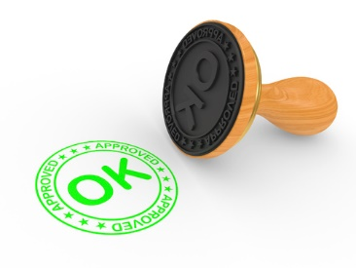
ICEG Education vocabulary
Let us take advantage of these efforts and work together to achieve, for the exchange of educational data …
a Belgian ICEG standard,
a European standard.
This European standard could be ours.

